Slide 1
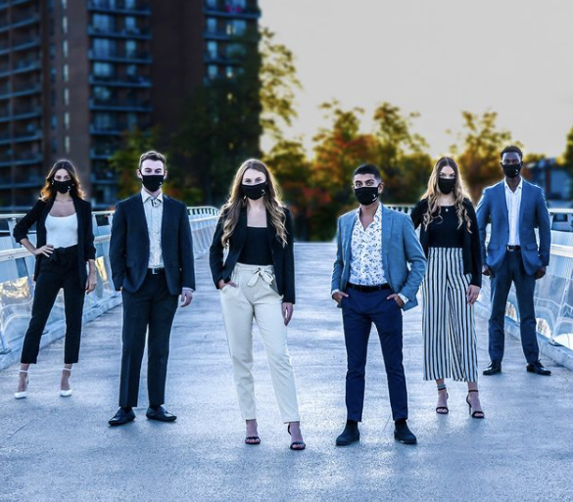
SBSS Annual General Meeting
January 29, 2021

Slide 2
Tonight’s Agenda
2020-2021 Midterm Report
Portfolio Achievements
Sprott Club Midterm Updates
Upcoming SBSS Events
Clubs 1 on 1
Q&A

Slide 3
SBSS Mission
The Sprott Business Students' Society represents all undergraduate students at the Sprott School of Business. We are a volunteer organization run entirely by business students, for business students. We fund, organize and run social, professional and academic events to integrate the business community at Carleton University.
sbssonline.ca @SBSSCouncil

Slide 4
Waive The Right For A Public Accountant
Hiring a public accountant is incredibly costly (>$30,000) and does not align with our organization’s needs
Money would be better spent on giving back to students!!!

Slide 5
Exec Team

Slide 6
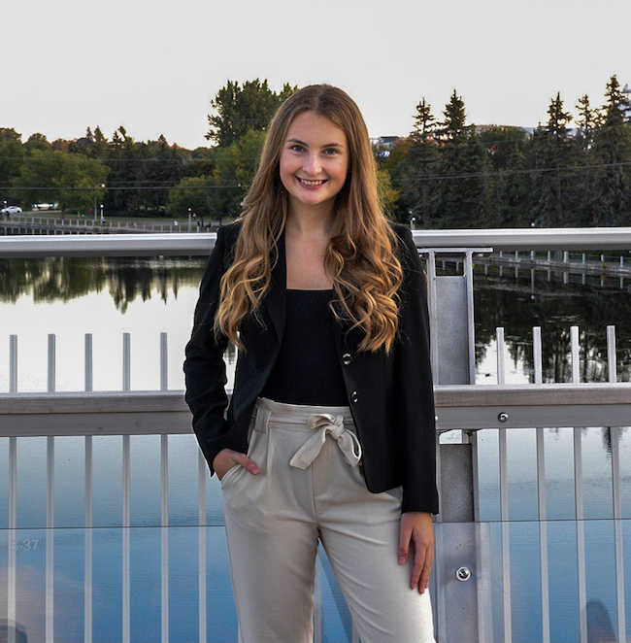
President
Emily Buchkowsky
Goals Accomplished
SBSS Response to COVID-19
Devised a contingency plan to ensure the SBSS provides
students with opportunities despite if learning is shifted online.
Offered a variety of online events that appeal to different students.
Student Engagement
Increase engagement from students on our social platforms and events
Provide more incentives for students to attend and participate.
Improve External Relations
Offer a variety of non-monetary opportunities for companies to join our events.

Slide 7
Goals to be Achieved
Implement Community Guidelines
Alumni Address Book

Slide 8
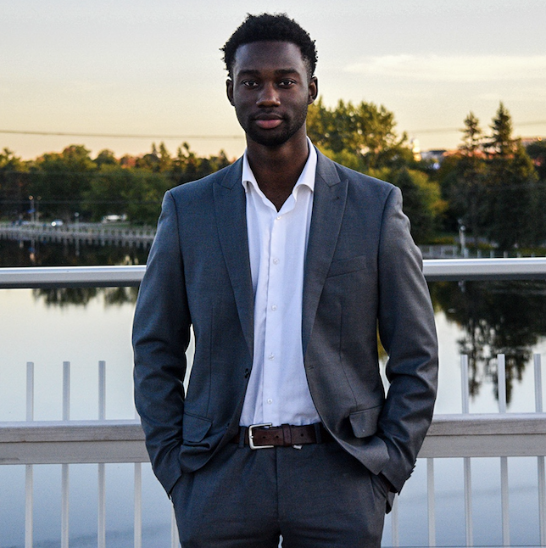
VP Finance
Aaron Agyemang
Goals Accomplished
Ensured the SBSS remained financially stable despite the unpredictability COVID-19 imposed
Improved relationship with faculty for levy transference and financial support

Slide 9
Goals to be Achieved
Continue to be fiscally conservative while maintaining event integrity for the rest of the year

Slide 10
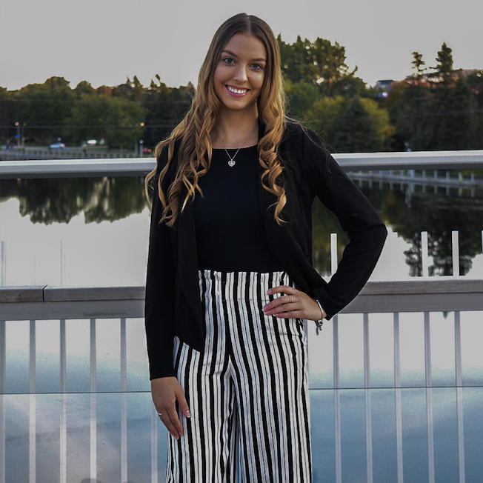
VP Internal Relations
Alexa Camick
Goals Accomplished
SBSS Council cohesiveness and inclusivity
Council Socials and interactive full council meetings
Reinforce disciplinary policy to all members
Get to know club leadership early on in the year - Summer 2020
Increase awareness of Sprott Clubs’ events - Social Media
Equity & Inclusion Director

Slide 11
Goals to be Achieved
Clubs social event
Improve relationships between SBSS and all Sprott clubs
One on ones in March with Corporate Clubs
E&I Panel Event
Continue to support the SBSS Council

Slide 12
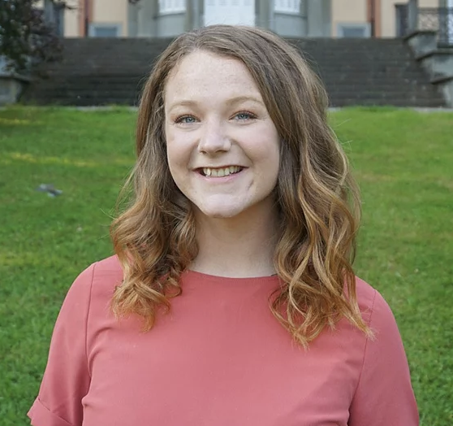
VP Academics
Ceiledh Monk
Goals Accomplished
Attracting more students to academic events and engaging them in initiatives
Bring our Internal Case Competition up a notch despite being online
Portfolio management by creating structured roles and hosting more intra-portfolio bonding

Slide 13
Goals to be Achieved
Investing for Dummies workshop on Feb 10th at 4-5pm EST
Host our First Year Event - Pitch it or Ditch it on March 4th
Second semester study sessions and wellness events
Notes:
28 students registered for our upcoming workshop!

Slide 14
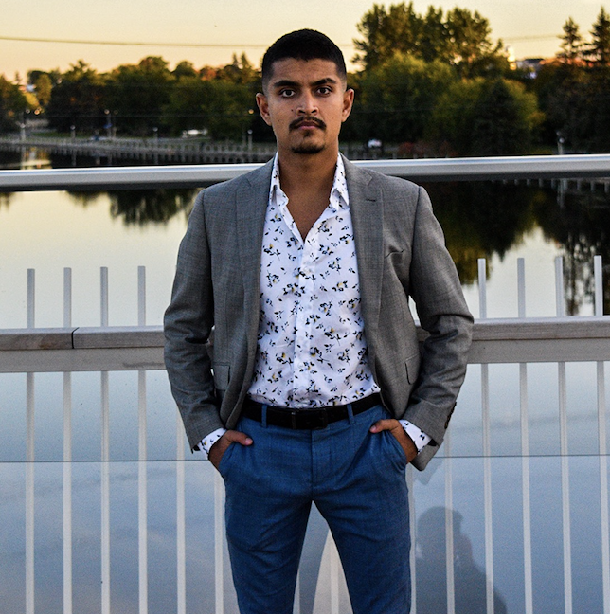
VP Marketing
Jon Moore
Goals Accomplished
COVID Social Media Engagement - Create interesting social media content that engages with Sprott students. This was completed by the increasing the number and diversity of our blog posts, introducing the Sprottlight Podcast which airs biweekly, using tik-tok in the summer, and creating both engaging story and feed posts that are informative and eye-catching.
Brand Image - Enforce a clear image that spans both the SBSS social media accounts and website. This shows cohesiveness and attention to detail.

Slide 15
Student engagement - Saw a 300+ follower increase on Instagram (mostly first years - which is good), and a large increase in interaction and reach between students and the graphics we post
Club Promotion: Ran a series in the summer highlighting all concentration clubs (that emailed back) and have avidly promoted clubs via our stories.
Updated information at all times - all online questions responded to in less than 24 hours, all website information was continually updated and accurate, and event highlights were always promoted within a week (all good).

Slide 16
Goals to be Achieved
Film in person videos
Take in person photos
Merch

Slide 17
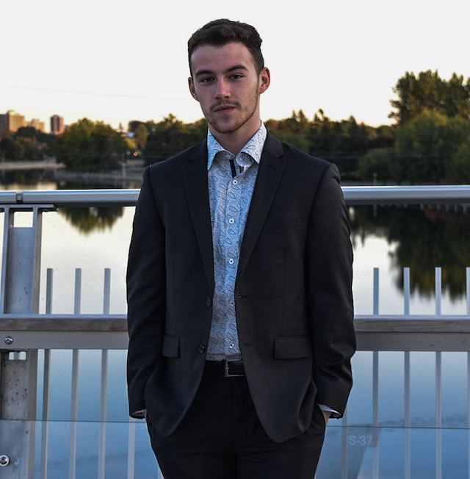
VP Student Life
Michael Ionescu
Goals Accomplished
Athletics
Successfully ran the New Year’s Resolution Fitness Challenge month
Introduced our first Major League Sports Watch Party for the NBA Finals
Social
Proudly hosted SBSS’ first virtual Paint Night
Successful Student Appreciation Week (Care Packages)
Charity
Movember Bingo Night

Slide 18
Goals to be Achieved
Relay for Life
Increase participation from council
Raise $1,000
5 Days for the Homeless
Raise $2,500
Raise awareness for the 5 days campaign
Alternatives to in-person campaign

Slide 19
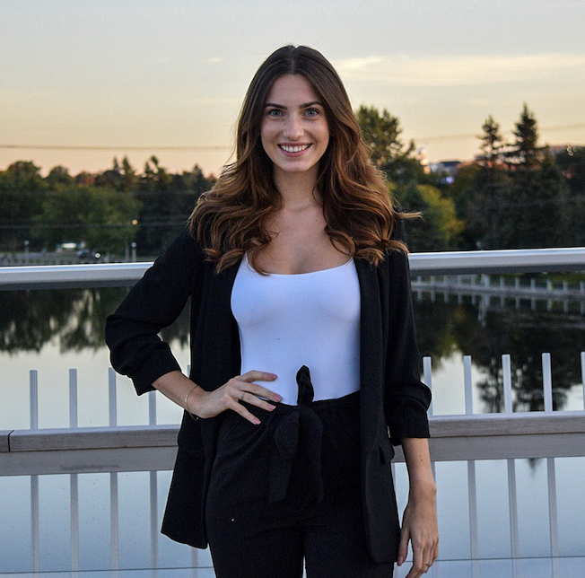
VP External Relations
Samantha Gec
Goals Accomplished
Provided Networking opportunities to students
Implementation of the Virtual Networking Series
Increased cohesiveness amongst the External Portofolio
Clearer communication amongst directors
Further developed the External Portfolio
Implementation of two Corporate Managers
Revamped the Corporate Partnership Package (CPP)
Provided more clarity to potential partners by communicating exact offerings of SBSS events in Sponsorship agreements
Notes:
Hi Lex, this is all for me

Slide 20
Goals to be Achieved
Hold at least two more Virtual Networking events in an effort to
Increase student engagement
Provide networking opportunities for students
Diversify the SBSS contact list
Continue to diversify the SBSS contact list through External held events and sponsorship of other SBSS-run events
Further develop the roles of Corporate Managers

Slide 21
Sprott Clubs

Slide 22
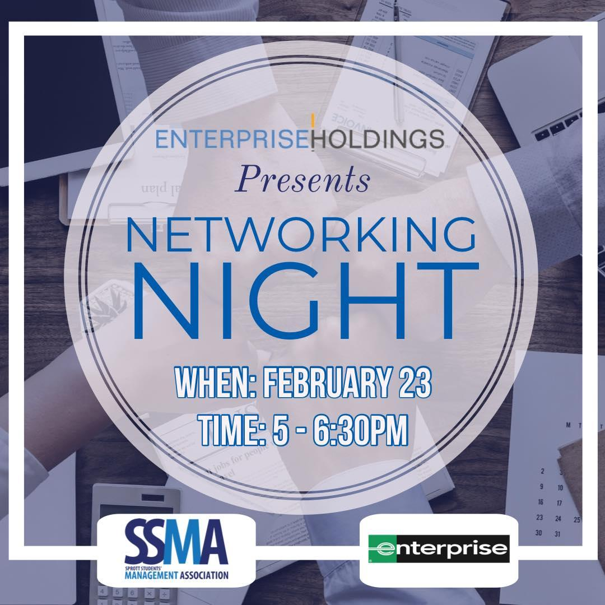
SSMA 2020-2021 Updates
Improved club activity + student engagement – 3 fall events
Website development
Increased relations with external stakeholders
Setting foundation for Fall 2021 events
Improving student attendance (>40)
Winter Semester Events
Enterprise Networking Night - Feb 23rd , 5 to 6:30pm
BCMC X SSMA Virtual and Workplace Etiquette – March 3rd , 5 to 6pm
Workplace culture at Shopify – March 18th, 5 to 6:30pm
SFSA X SSMA Kahoot Night– April 1st , 6 to 8pm

Slide 23
ACCOMPLISHMENTS & PLANS
Successful Past Projects
Completion of TEMBO Project
Completion of IEI Project
Successful Past Events
Indigenous Entrepreneurship Panel
Social Impact Measurement & Social Purpose Businesses Workshop
PLANS/ Winter Events
Social Media Campaign
Scholarship Ceremony
Case competition (DECA & SSIC)
Career Beyond a Degree: ( SSIC & BCMC)
Networking (SIBA & SSIC)
Public speaking for internal

Slide 26
SISSA 2020-2021 ACCOMPLISHMENTS
EXPANDED OUR WORKSHOP SERIES TO A MORE TECHNICAL PERSPECTIVE (SQL).
EXCEEDED PRIOR YEAR ATTENDEE NUMBERS AT OUR EXCEL WORKSHOP.
SPREAD THE WORD OF THE INFORMATION SYSTEMS CONCENTRATION.
INCREASED OUR SOCIAL MEDIA PRESENCE AND ENHANCED OUR PLATFORMS TO COMPETE IN THE NEW ONLINE WORLD.
MAKE SOME GREAT CONNECTIONS AND MEMORIES.
Notes:
NOTES:
We expanded out workshop series this year to become more technical. We offered an SQL coding workshop in the Fall term which was a big hit for many students. So much so that we will be doing another in the winter term in Python.
Our excel workshop had an exceptional 75 attendees (400% increase to prior years) which was our largest event to date.
The main goal our club had this term was to spread the word of the information systems concentration and we succeeded. We did this mainly by bringing in a devoted IS first year student, Hayley Van Kessel. She on a number of occasions promoted our events and our club to her peer and classmates. She also had other SISSA execs to come in and promote upcoming events and talk about the concentration to her 1800 class.
From shifting to an online environment, SISSA had to up their game with social media. We concurred this by creating more engaging content and with help from other clubs we were able to spread the word more. We also created a linktree for easier sign-up to events.
Overall as a club, we shared some great memories and experiences with the student body. We are looking forward to continuing.

Slide 27
SASA AGM 2020-2021 Slides
Presented by Katelyne Clackett, VP Internal

Slide 28
An overview of 2020-2021 so far...
SASA has been hard at work this year to continuously innovate and upgrade the offerings for students. Below are just a highlight of what we have accomplished and what’s coming for the rest of the year!
Successfully shifted all SASA networking events online, and returned similar numbers to in person events
Expanded workshop offerings to better develop accounting students across Sprott
On track to host a fully virtual tax clinic for all Carleton students
Launched first ever conference: Accounting for the Future. Tickets still available until 9 pm tonight at cusasa.ca/events

Slide 29
Where SASA is heading for next year...
Here’s the areas where SASA is working to make things even better next year!
Working on a plan to return events in person where possible in 2021-2022 in a safe way
Continuing to alter event lineup to give students more opportunities to learn and develop
Foster new and exciting partnerships both internally and externally
Optimize internal structures to better organize events
Continue to build social media presence and find ways to better connect with students
Develop new executives and ensure team continues to function smoothly
Contingencies for online/offline events for the year

Slide 30
SFSA 2020-2021 Updates
Structural changes + hiring of ambassadors
Website development
2 Fall events, 4 Winter events – Active after 2 years
Improving student attendance
Winter Semester Events
FinTech Panel- Feb 9th , 6 to 8pm
Financial Modelling Workshop – March 10th , 6 to 8pm
TFSA Workshop– March 10th, 6 to 8pm
SFSA X SSMA Kahoot Night– April 1st , 6 to 8pm

Slide 31
2020-2021 Accomplishments
Created and implemented there different online social media marketing campaigns.
Created and maintained SMSA’s first Blog on our newly updated website.
Hosted Let’s Talk Marketing, a marketing career panel with a 50% increase in attendance rate from previous years event.
Hosted Marketing Mix and Mingle Game Night in the Virtual Sprott Lounge.
Planning in conjunction with Leighann Neilson and Rowland Few a Sales Career Panel to take place in March.
Participating and raising money for Relay for Life happening in March.

Slide 32
S T U D E N T S
D E V E L O P M E N T
10 3 75
Workshops
6 weeks
12 total
18 hours total
Office Hours
7 weeks
46 hours total
Executives Interns Delegates
N A T I O N A L S
E V O L V E
Invitational
Case Comp
45 Delegates, 8 Awarded
37 Internal, 7 External
B2B
Management
Consulting
HRM
Sports & Ent
Marketing
Travel
Management
1st – Daniel Cheung & Ameesha Goel
Sam Cook & Trevor Anderson (Tie)
1st – Michael Antram
2nd – Quinn Cunnane
3rd = Alanna Errington
1st – Sakina Janmohamed & Nicole Gluzman
1st – Julia Gros & Eric Chirilia
2nd – Ethan Defreitas & Nolan Smith
3rd – Tiam Nazardad & Sahar Ebrahimisirizi
1st – Karen Nguyen
2nd – David Deroode
3rd – Grace Torrie
ADC Challenge – 3rd
International Marketing – 3rd
Accounting – Top 5
Fashion Retail Management – Top 5
Restaurant & Food Management – 3rd
Rachel Koops
Zach Viquiera
Ty Payton
Orr Gubbay
Liesl Kennedy
Therese Bergmann
Theresa Kelly
Imran Kassam

Slide 33
SPROTT SUPPLY CHAIN MANAGEMENT ASSOCIATION
Accomplishments in 2019-20 Campaign
New Logo
Launched Website
6 New Executive Members
Introduced the Ambassador Position
CPA Ontario Sponsorship
Events:
3rd Annual Supply Chain Career Panel
30% increase in attendance
Introduced 3 new events
CPA x SSCMA: E-Commerce Workshop
APICS x SSCMA Giant Tiger Warehouse Tour
SISSA X SSCMA Alumni Connect
Accomplishments in 2020-21 Campaign
Expansion of our team through the Ambassador program
Partnership with Noir Shots
Events:
4th Annual APICS Career Panel
SSCMA Career Panel
Fall & Winter
Alumni Connect

Slide 34
Upcoming

Slide 35
Upcoming SBSS Events
Presidential Voting
Today! - on CuLearn for members
Virtual Networking
Wednesday, Feb 3rd
New Investments Workshop
Wednesday, Feb 10th
Bake-off
Friday, Feb 12th - Tuesday, Feb 16th
E-Sports
Thursday, Feb 18th - Sunday, Feb 28th
Director Applications
Open Monday, Feb 22nd
Merch Launch
March
Equity & Inclusion Panel
March

Slide 36
Clubs 1 on 1
First week of March

Slide 37
Stay Connected
Follow us on social media or check out our website!
sbssonline.ca
@sbsscouncil
Sprott Business Students’ Society
sbssonline.ca @SBSSCouncil

Slide 38
Presidential Voting Day is Today!!
via cuLearn

Slide 39
Q&A

